Slide 1

Lending Club Default Prediction
-XU ZHOU

Slide 2

Background
Lending Club: P2P lending platform
Return: -9.4% to +13.8%
Questions:
How to predict default?
Anyway to manage outcome?
How to make better decisions?

Slide 3
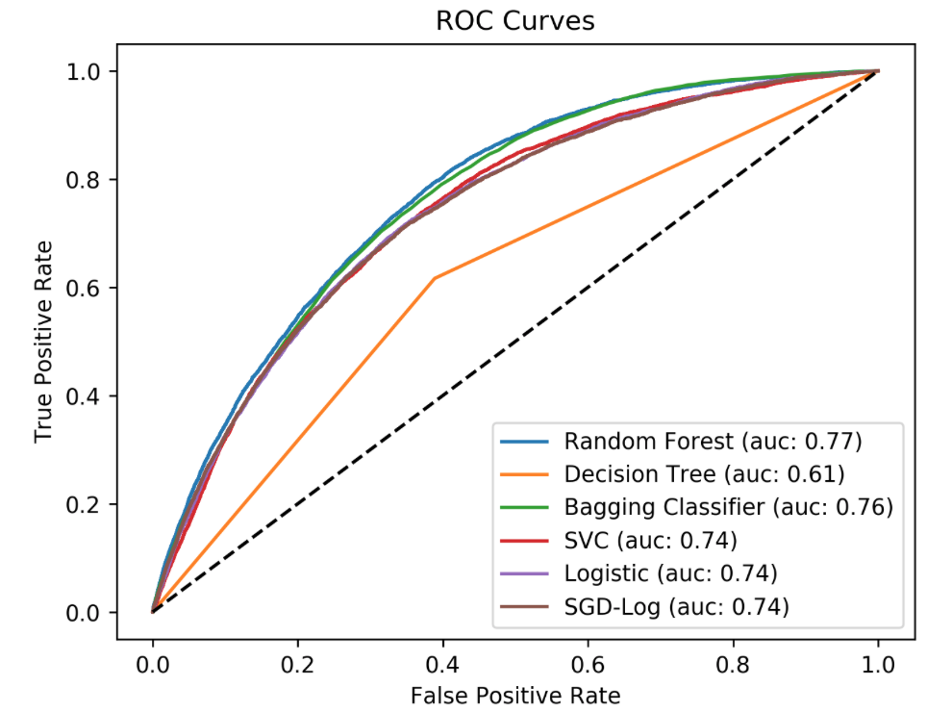
Approach
Challenges:
Highly imbalanced data
Many categorical features
Data transformation
Model Selection

Slide 4
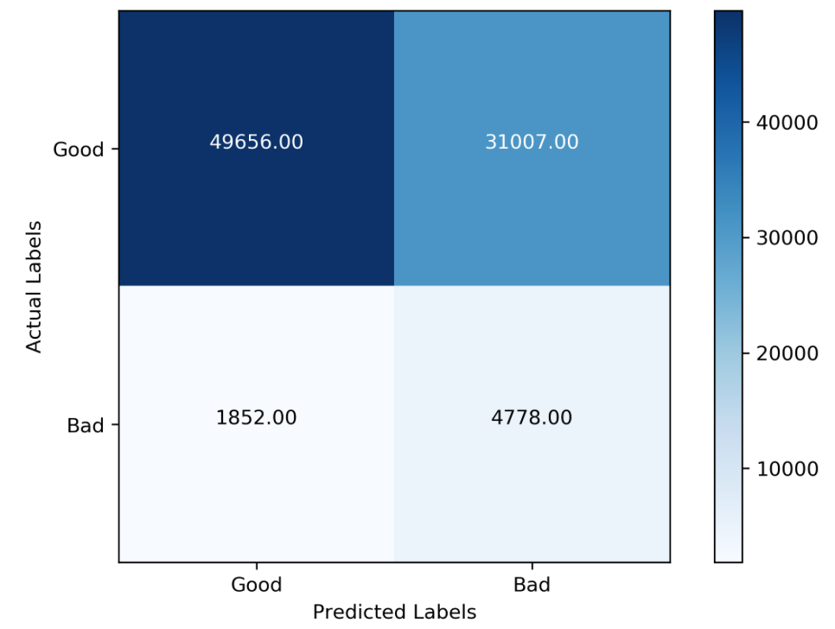
Modeling and Finding
( 92.4% )
( 56.9% )
( 35.5% )
Optimized model
True Positive: 72%
Top factors driving the default
Interest Rate
Inquiries of Last 6 Months
Loan Grade
( 7.6% )
( 2.1% )
( 5.5% )

Slide 5
Upcoming App
Good investment. You loan is predicted to have a default rate of 12.4%

Slide 6
Take-aways and Next Steps
Take-aways
Loans are not created equal
Use our model to make better decisions
Next steps
Continuous improvement
Mass prediction
Evaluate behavior changes over time

